Slide 1
Today’s Agenda (1 hour)
Quick review of Ethical Ruling 1.1 and 1.6
The cloud (review - in a nutshell)
Protecting your customers’ data
Encryption
VPN
Common security threats
Emails Best Practice
Password Management

Slide 2
Pleasure to meet you !
Your name and firm name
Mac or PC or a mix?
Years in business

Slide 3
Presented by:
Beits (Eitan) Livneh
Managing Partner/ Founder
“Legal Technology Solutions”
Born in Tel Aviv, Israel, 1978
In the technology field since 1996
IDF/ Intelligence force, 1996-1999
Married to Christina, and to his job…
Children: 4 (ages 8,10,10,10)
Hobbies: Connect people together, Grow businesses and study new technologies.
Linkedin.com/in/LegalTechSolutions
www.LegalTechnology.Solutions 480-614-4227

Slide 4
Ethical ruling 1.1, 1.6
ER: 1.1 dictates that you must provide competent representation. The ABA has since extended this ruling to include knowledge of the risks and benefits of technology.
ER: 1.6 Requires confidentiality, and this, too, requires you take reasonable steps to provide confidentiality when it comes to e-documents.

Slide 5
Protecting your client’s data
Since you know it’s YOUR responsibility, and regardless of your firm’s size:
Understand threat sources:
Existing or X-employees
Competition – to win a case
Competition – reputation headaches
Random hackers/ Ransom
Frustrated clients
Old IT provider trying to win you back
Old IT provider’s employee trying to cause damage
Same for office equipment provider, camera/ security company provider, etc.
Don’t just hire employees / vendors/ contractors- you must vet them, and make sure they are not risking your student loans…
Choose your technology carefully… Using the free Drobox service is NOT OK! (although super easy). Using the latest and greatest might not be always good
Choose the right cloud provider for your cloud services.
Use GOOD passwords (we’ll explain in a few minutes)
Encrypt your data. Always assume someone is watching
Understand that adding SECURITY comes with a cost (financial, time/ convenience). There is no way around it yet, but it’s not THAT complicated.
Use VPN
Understand common threats sources
Keep educating yourself- there are new threats every few minutes, so monthly newsletter or quarterly CLE should be considered

Slide 6
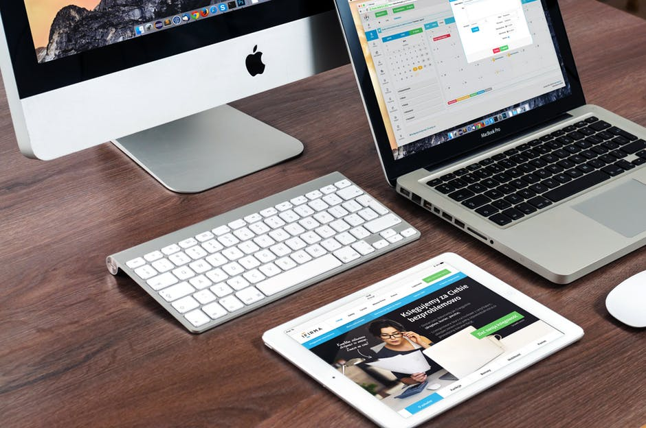
What is the “cloud”?
New “marketing” approach to technology that we’ve had for a loooooong time…
Gmail, Yahoo, AOL, Hotmail/ Outlook.com – all cloud computing…
The “new Cloud”: SaaS (Software as a service). Examples: Google Docs, Office 365, OWA, Quickbooks, Clio, Adobe, WEVIDEO

Slide 7
Cloud benefits
Scalability
Add/ remote users as needed
Pay as you go
Disaster planning
“Co-location”
Off-site backup
Lower IT costs
No hardware
No software
On “maintenance” in most cases
Quick access from anywhere
Big Data- using collected information to better our lives…
“blue sky”

Slide 8
Cloud risks
Hacking target
Hack into Microsoft? Or Joe’s coffee shop?
Data security
Data ownership
Segregation between customers
Encryption
NSA/ Federal “show me the data”…
No internet- no access…
Retention requirements/ compliance
Disaster recovery
“dark sky”

Slide 9
Choosing the right provider
First- ask yourself WHAT are you hoping to accomplish in the cloud…
Reduce operations cost?
Automatic backup destination?
Archive of old data?
Collaboration and application sharing?
Don’t re-invent the wheel… look for a company with reputation
Is the provider’s facility complied with HIPAA/ SEC?
SLA- What will the provider guarantee, in terms of GUARANTEED of uptime, security, data ownership and access.
Who is in charge of maintenance of Operating System or software
DEVICE SUPPORT! (Can I connect from my iPad? Or just my PC?)
Remember the user… “K.I.S.S”

Slide 10
Choosing the right provider (cont’)
Access privileges – Cloud service providers should be able to demonstrate they enforce adequate hiring, oversight and access controls to enforce administrative delegation.
Regulatory compliance – YOU are accountable for your own data even when it’s in a public cloud, and you should ensure your providers are ready and willing to undergo audits.
Data provenance – When selecting a provider, ask where their datacenters are located and if they can commit to specific privacy requirements.
Data segregation – Most public clouds are shared environments, and it is critical to make sure hosting providers can guarantee complete data segregation for secure multi-tenancy.

Slide 12
Encryption
Encryption protects against breaches
Adds a layer of protection beyond passwords
It makes stolen data useless

Slide 13
Three common types of encryption
Hard drive encryption
Microsoft bitlocker or Apple FileVault
Encrypts the entire hard drive, and unencrypts it when you log in
This is not invasive BUT updates, hard restarts, power outages, and a bad hard drive can all cause your hard drive encryption to lock permanently. To mitigate damage, have a data restoration plan.
File encryption
Axcryptor and Boxcryptor
Encrypts specific folders or files
Workflow will change when implementing one of these.
Email Encryption
This encrypts individual emails
The recipient must know the passcode to access the email
The email only “lasts” for so long (ex: Deletes after a week)

Slide 14
VPN: “Virtual Private Network”
Connecting offices together
Connecting users to their office
Connecting users to their own devices
Masking internet tracks and traffic
The public sector VPN Evolution..

Slide 15
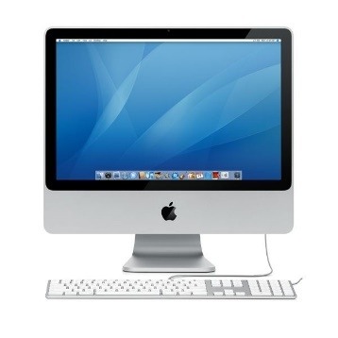
VPN: “Virtual Private Network”
Internet Provider (ISP)

Slide 16
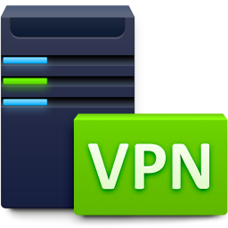
VPN: “Virtual Private Network”
Bypass all monitoring devices between YOUR DEVICE And the “internet”
It’s not YOUR computer that is connecting to the internet- it’s your INTERNET PROVIDER. VPN masks it…
Hardware OR software can be used

Slide 17
VPN: “Virtual Private Network”
Easy… VERY EASY! (VPN Software Solution)
(Links/ info provided at the end of this slide)
Create an account on one of the dozens of services. Example: VPN.S
Download the VPN software (https://www.vpnsecure.me/download)
Install the Configuration File
Connect to the VPN!
Now you can:
Surf the internet with not showing who you are, or WHERE you are
Join wireless networks and surf securely

Slide 18
Common Law Firm Security Threats
Security Issues:
Opening or clicking within spam emails
Sending unencrypted emails with confidential information. Unencrypted emails are like postcards
Weak passwords that are shared
Not having a response plan for breaches or data disasters
Not having a procedure to terminate employee access when they are fired/quit
Not encrypting device hard drives
Reasons for being hacked:
They have some motive (ex: financial, reputation)
They aren’t after you, they’re after your client
You are just a practice
They intentionally or unintentionally found access (ex: Lost laptop, IP address)
You were the easy target out of the pool of prospective targets

Slide 19
Email Best Practice
Almost all our passwords, for all sites/ programs, can be reset using “forgot password” email reminder…
Someone with access to your email can access almost anything else that you used that Email account with on registration
Secure your Email account like you secure your social security number
GREAT password + Use two factor authentication
Use server/ service with log options
Use email/ IT provider that you TRUST and can TRACK
Don’t “remember password”
Use Archiving service
Back up your Emails !!!! (example- Godaddy)
Send sensitive info using ENCRYPTED email
Don’t forget contacts/ calendars are synced with your phone. Don’t save customer/ sensitive data on calendar or contacts notes
Avoid G-Suite till we know more… Use Hosted Exchange

Slide 20
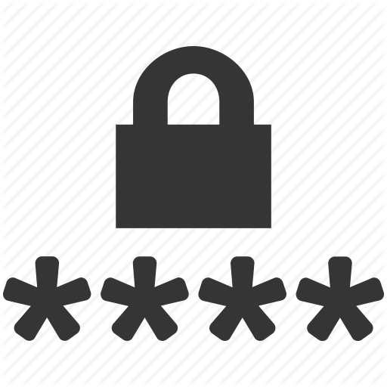
Password Management
Dictionary attack – Uses a file containing real words or common passwords and tests different combinations
Brute Force attack – Uses the dictionary method but also adds numbers and some symbols.
Spidering – Gaining knowledge about the victim to customize a brute force attack
Social engineering/Phishing – Send an email, call in as IT support, or gain access and shoulder surf.
Rainbow attack – Uses a table of common hashes to crack your hash, but requires access to password hashes. (Hash-the scrambled version of your password)
Malware – A key logger that tracks everything you type
Password Reset - Exploiting Password Reset services to Hijack accounts

Slide 21
Password Management
Passwords are crucial to security!
NEW advice was released by National Institute of Standards and Technology (NIST) (August, 2016) AND Microsoft (May 2016).
My recommendations are based on these standards and many more.
Resources:
https://pages.nist.gov/800-63-3/sp800-63-3.html
https://www.semperis.com/microsoft-upends-traditional-password-recommendations-with-significant-new-guidance/
https://nakedsecurity.sophos.com/2016/08/18/nists-new-password-rules-what-you-need-to-know

Slide 22
How to create a safe password
Re-learn about passwords. Replace “strong passwords” with “unique and memorable passwords”
Understand that all password structures have vulnerabilities
A lot of methods exist, here are my favorites:
The Pass Phrase method (“NoseBirdBrings”) (“Today I Choose To Be Happy.”)
Pass Phrase initialism – like an acronym (MVWBDI1995SIWH.)

Slide 23
The “do’s” and “don’ts”
Choose something unique (Don’t use your email or facebook password)
Make password AT LEAST 8 characters long (for extra security, aim for 20 characters, but do not compromise the other Do’s and Don’ts)
No repeating the same password twice “passwordpassword” or “dec18thdec18th”
No “silly” passwords such as “password”, “changeMe123”, “myPa$$w0rd”
No password hints
Make it easy to remember but hard to guess
BlueDiceInMy78RockWagon - good
BDiM78Rw – good
LogMeInNow2016 – not good
Try to avoid using TRUTHS about your life “Kim2001”

Slide 24
The “dos” and “don’ts” continued
Eliminate computer password policies – These help hackers
No more composition rules. Stop making passwords unnecessarily complicated. Adding an “!” or making the first letter capital does not make it more secure.
No Knowledge based authentication (What is the name of your pet?)
No more password expirations without reason: Conditions to reset password:
Forgotten
Stolen
May have been phished
Reason to believe it was compromised
Annually
(ASK your IT) Hash and salt passwords before storing them. This means you need:
a salt of 32 bits or more
a Secure Hash Algorithm (SHA-1, SHA-2 or SHA-3)
and the “stretching” algorithm PBKDF2 with at least 10,000 iterations.

Slide 25
Other Password Recommendations
Two factor authentication
Biometric passwords (Fingerprint, faceprint, or handwriting)
Use a password manager (LastPass).
Con: This is loved and hated by Security Professionals because all passwords are stored in the same place. I recommend having a long (16-30 character), unique MASTERPASSWORD. (MasterPassword unlocks the app to see stored passwords)
Pro: Autogenerate very complex passwords for all applications, and use 1 MASTERPASSWORD to autofill these passwords.

Slide 26
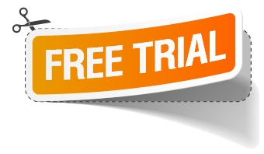
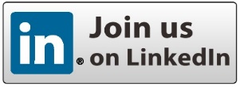
Stay in touch… We are here to help YOU!
www.LegalTechnology.Solutions/trial
www.LegalTechnology.Solutions/blog
www.Linkedin.com/in/LegalTechSolutions
www.LegalTechnology.Solutions/beits
I.T help: 480-614-4227, or
www.LegalTechnology.Solutions/contact

